Slide 1
Biological orientation responses of plants

Slide 2
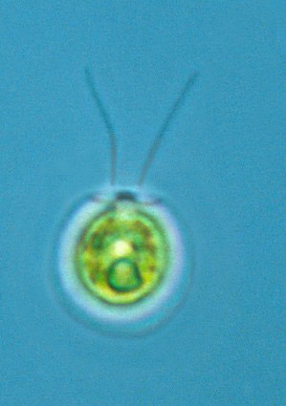
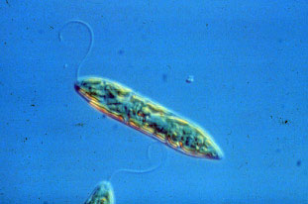
Taxes
A taxis is the movement of the whole organism toward or away from a stimulus coming from one direction.
No true plants can move in this way but some free-swimming algae swim toward light – positive phototaxis. E.g. Euglena and Chlamydomonas

Slide 3

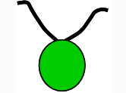

Positive Phototaxis in Chlamydomonas

Slide 4
Nastic responses
Plant response to a stimulus that is independent of the direction of the stimulus
Changes in turgor pressure in plant cells can result in rapid movements.
Caused by a change in the intensity of an environmental stimulus – e.g. light, (photonasty), temperature (thermonasty)
Examples: flowers opening and closing

Slide 5
Argentine Giant Cactus
It's flowers normally open at night and persist until early morning. The bright white petals and yellow centers attract night pollinators such as, moths and bats.
While it is said to be a nocturnal blooming cactus with the flowers closing at early morning. On cool, cloudy days in Arizona; the flowers continue blooming during the day.

Slide 6
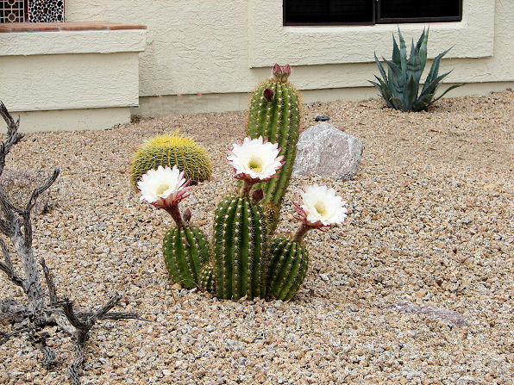
Argentine Giant Cactus

Slide 7
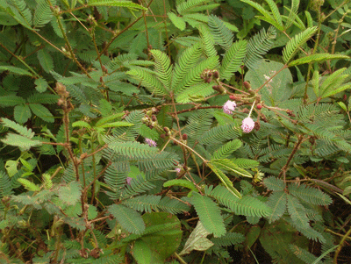
Thigmonasty in Mimosa

Slide 8
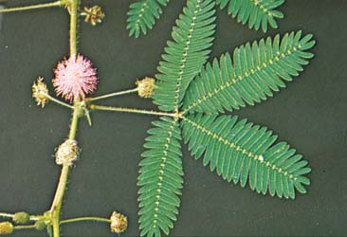
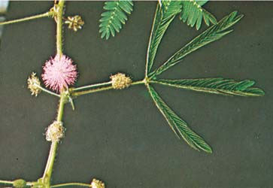
The leaflets of Mimosa close if they are touched.

Slide 9
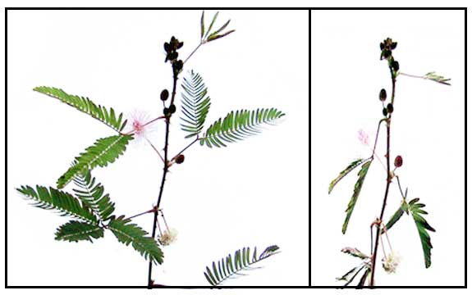
The whole leaf will fold down if stimulated further.
Does this protect from wind or herbivores?

Slide 10
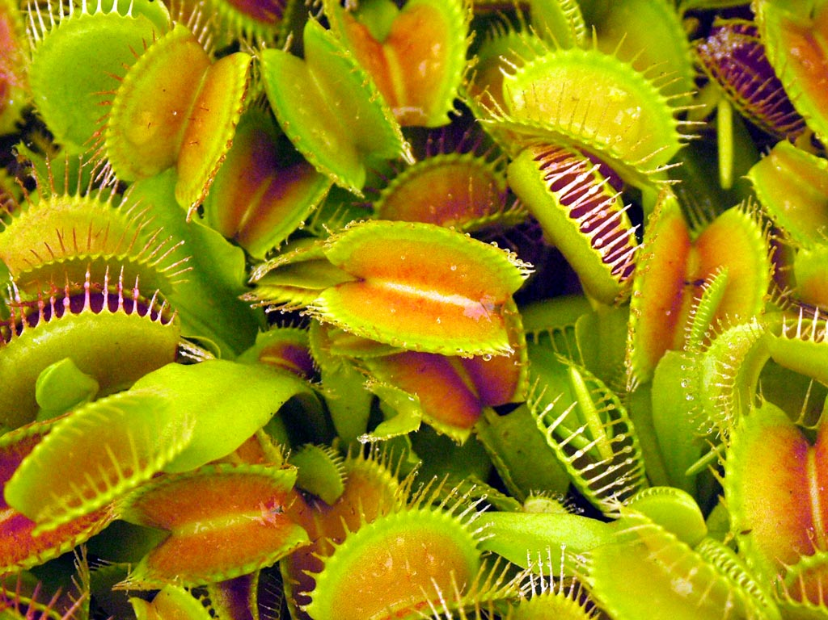
Venus flytrap

Slide 11
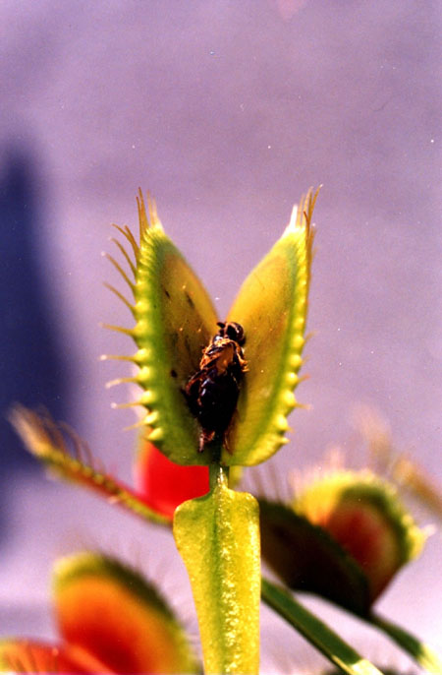
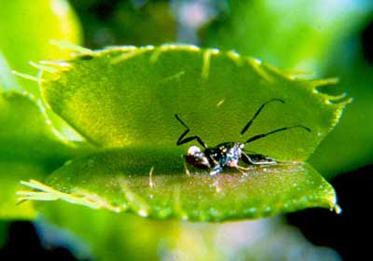

Slide 12

A big one!

Slide 13
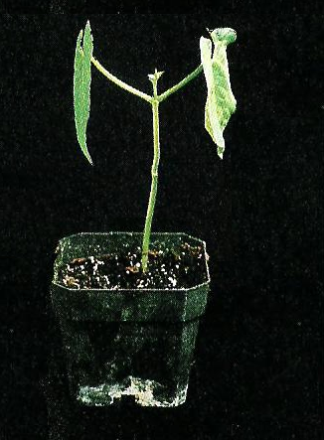
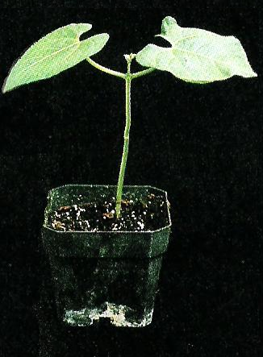
Sleep movements in beans (Photonasty)
Could they be avoiding bright moonlight that would upset their photoperiodism?

Slide 14
Tropisms
Growth responses directed toward or away from a stimulus.
Examples:
Phototropism
Geotropism
Hydrotropism
Thigmotropism

Slide 15
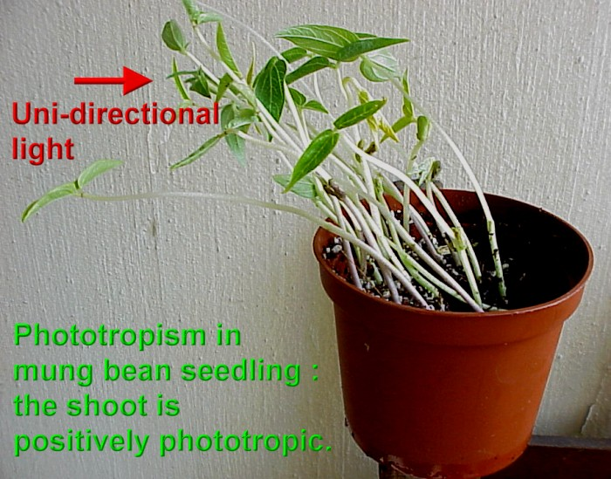
Positive Phototropism

Slide 16
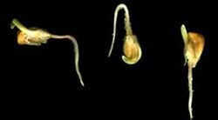
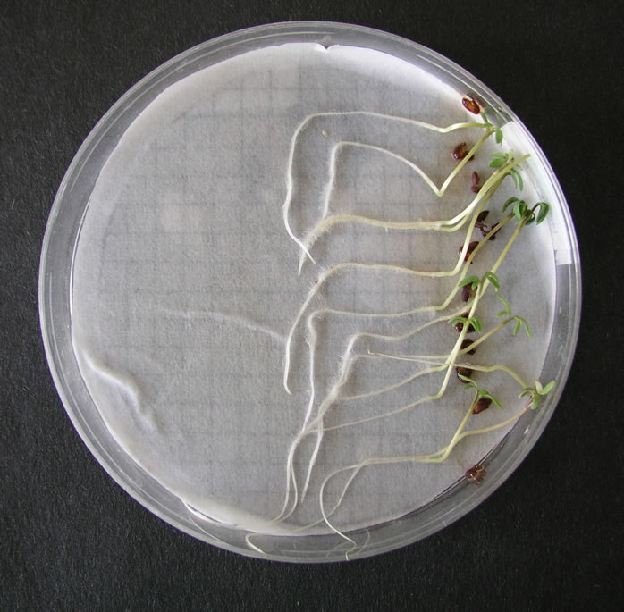
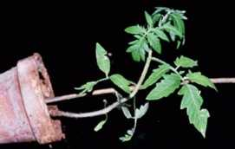
Geotropism
Root – positive
Shoot – negative

Slide 17
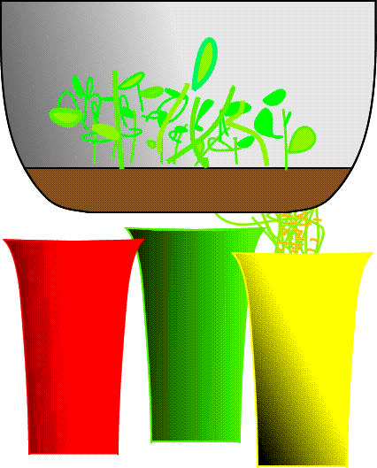
Positive hydrotropism

Slide 18
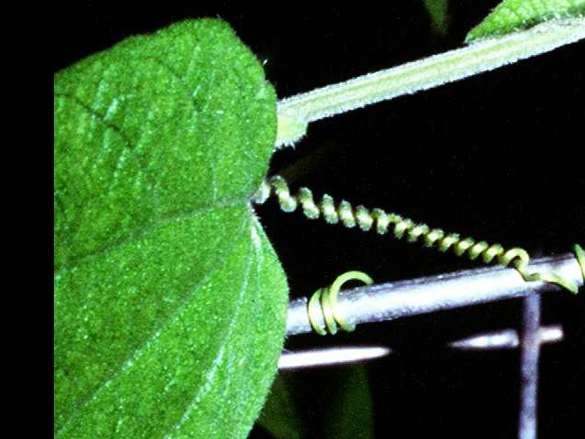
Positive thigmotropism

Slide 19
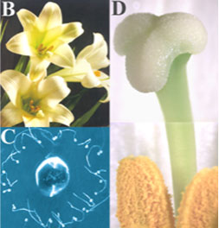
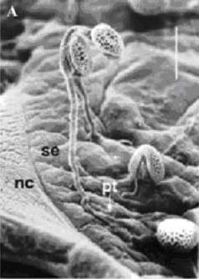
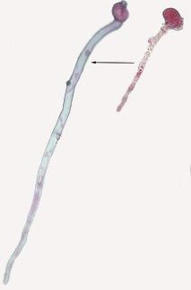
Positive chemotropism in pollen tube growth

Slide 20
Control of plant growth
This is mainly achieved by chemicals:- hormones and phytochromes.
Hormones are chemicals produced in one part of an organism, are carried elsewhere in the plant to produce a response.

Slide 21
Auxins
There is one natural auxin, indole acetic acid (IAA). Artificial auxins are used in weed sprays.
It is produced in meristematic cells (which are the fast dividing cells in stem and root tips).
IAA is water soluble and can pass through gelatin but not mica (a mineral).
IAA (in the right concentration) causes cells to elongate.

Slide 22
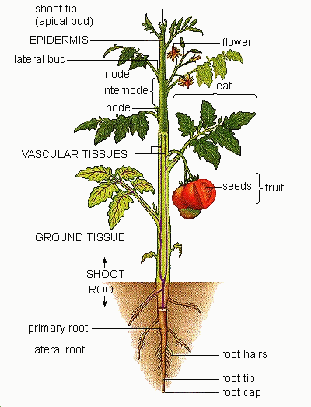
Meristem
Here – apical bud
Where is it?
Here – axillary bud
Here – root tip

Slide 23
Auxin and positive phototropism
When light is shone on the side of a growing shoot tip, the auxin produced in the tip migrates toward the shaded side as it moves down and causes elongation of the cells in the “zone of elongation”

Slide 24
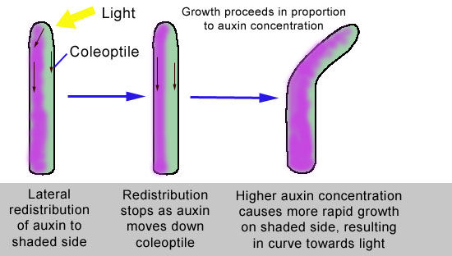
+ve phototropism in an oat coleoptile (growing tip)

Slide 25
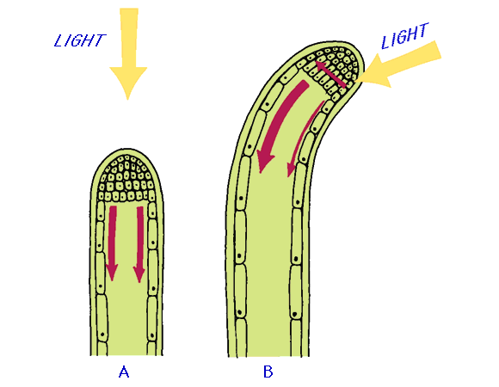
At a cellular level
More auxin
Auxin produced in tip. Mainly moves down shaded side
Auxin produced in tip moves down all sides evenly so elongation is even all around.
Greater elongation
Less auxin
Less elongation
Plant grows toward light

Slide 26
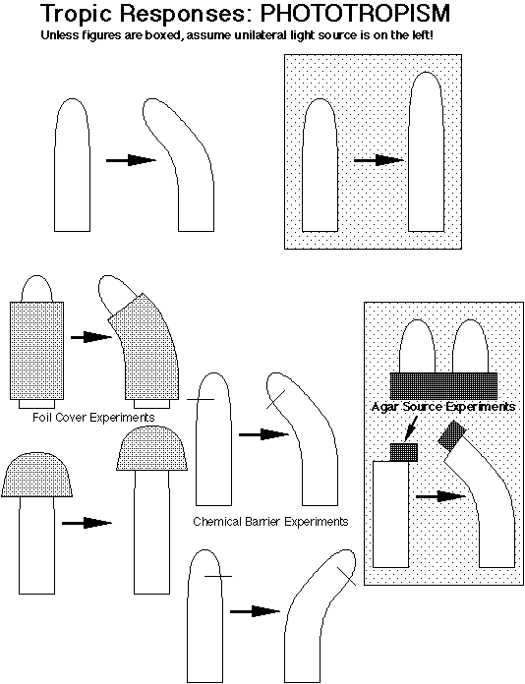

Slide 27
Effect of auxin on shoots and roots
This depends on the concentration of auxin and the tissue concerned
SEE PAGE 101

Slide 28
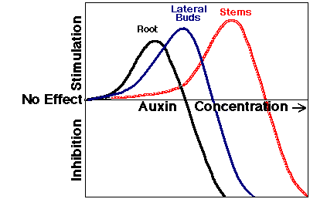

Slide 29
Summary
IAA Conc | Roots | Lateral Buds | Stems
Low | Stimulated | Stimulated | Inhibited
High | Inhibited | Inhibited | Stimulated

Slide 30
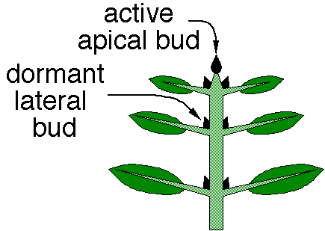
Apical Dominance
High concentration of auxin produced in the apical bud stimulates elongation of the stem but inhibits growth of lateral buds

Slide 31

Apical bud removed
If the apical bud is removed, the laterals are no longer inhibited and can grow.
The top buds usually takes over and inhibit the ones below them.

Slide 32
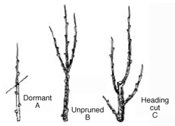
Pruning
Pruning can make a tree grow more bushy

Slide 33
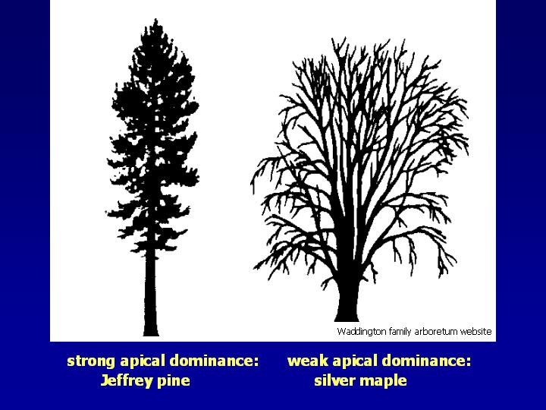
Plants vary in the amount of apical dominance. Conifers with strong apical dominance are more conical in shape

Slide 34
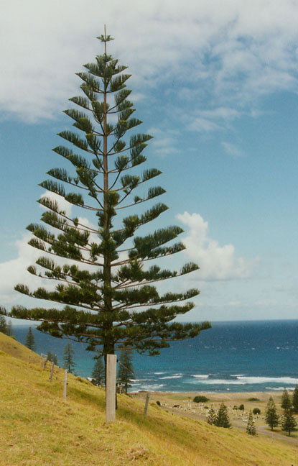
Norfolk Pine

Slide 35
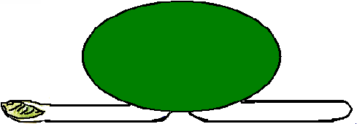
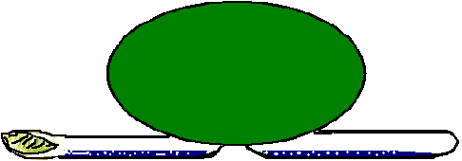
Geotropism
If a germinating seed is placed horizontally auxin made in the shoot and root tips is carried down because of gravity.
Auxin moves down
Auxin moves down

Slide 36
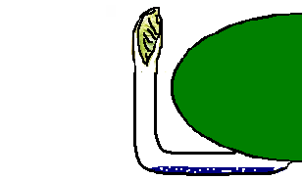
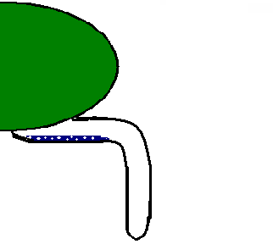
High auxin concentration stimulates elongation in shoot cells so the shoot bends up.
High auxin concentration inhibits root cell elongation so the root bends down

Slide 37
Other effects of auxin
Initiation of root formation; – used in powder on cuttings to stimulate root formation
Suppression of root elongation
Suppression of lateral buds
Stimulates cell division in woody stem cells
Initiation of flowering in some plants
Prevents early leaf and fruit drop

